Slide 1
Abstract class & Interface
-Nikita Mahangade

Slide 2
Abstract class
Java abstract class is a class that can not be instantiated by itself, it needs to be subclassed by another class to use its properties. An abstract class is declared using the “abstract” keyword in its class definition.
Abstract classes are a key component of OOP in Java, allowing to define incomplete classes that other classes can extend.
A class which is declared as abstract is known as an abstract class. It can have abstract and non-abstract methods. It needs to be extended and its method implemented.

Slide 3
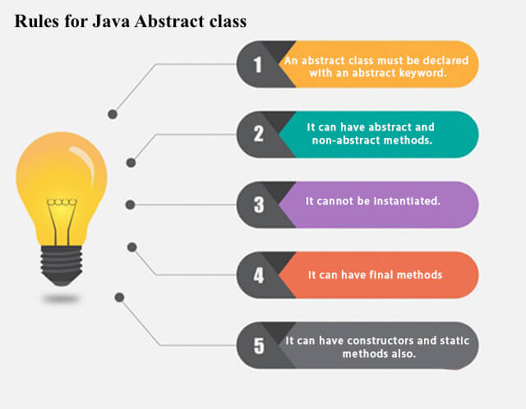

Slide 4
Syntax of an Abstract Class:
abstract class Animal {
// Abstract method (does not have a body)
abstract void sound();
// Regular method
void sleep() {
System.out.println("This animal is sleeping.");
}
}
class Dog extends Animal {
// Implementing the abstract method
void sound() {
System.out.println("Woof");a
}
}
class Main {
public static void main(String[] args) {
// Cannot instantiate an abstract class
// Animal animal = new Animal(); // Error
// Instantiate a subclass that provides implementation for the abstract method
Dog dog = new Dog();
dog.sound(); // Output: Woof
dog.sleep(); // Output: This animal is sleeping.
}
}

Slide 5
Characteristics of Abstract Class
Cannot be instantiated:
Abstract Methods:
Concrete Methods:
Instance Variables:
Constructors:
Inheritance:

Slide 6
Summary:
An abstract class in Java is a class that cannot be instantiated directly and may contain both abstract and concrete methods.
Abstract methods must be implemented by subclasses (unless the subclass is also abstract).
Concrete methods in an abstract class provide default behavior that can be inherited by subclasses.
Abstract classes are useful when you want to provide a common base class with shared functionality but leave some methods to be implemented by subclasses.

Slide 7
Interfaces
In Java, an interface is a reference type, similar to a class, that can contain only constants, method signatures, default methods, static methods, and nested types. An interface cannot contain instance fields or constructors. Interfaces are used to represent a contract for what a class can do, without specifying how the class will do it.
An interface in Java is a powerful tool for achieving abstraction and polymorphism. It allows you to define methods that must be implemented by any class that implements the interface, and it provides a way to achieve multiple inheritance of behaviors. With the addition of default and static methods in Java 8, interfaces have become even more versatile. They are essential for designing decoupled and flexible systems.

Slide 8
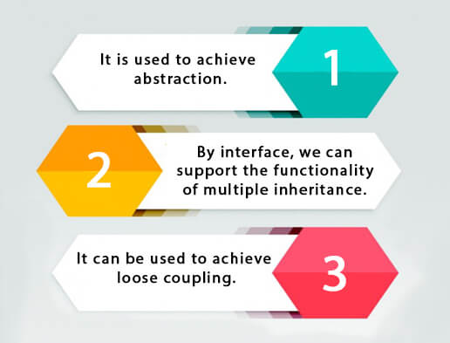
Use of Java interface

Slide 9
Declaration of interface
An interface is declared by using the interface keyword. It provides total abstraction; means all the methods in an interface are declared with the empty body, and all the fields are public, static and final by default. A class that implements an interface must implement all the methods declared in the interface.
interface <interface_name>{
// declare constant fields
// declare methods that abstract
// by default.
}

Slide 10
Interface vs Abstract Class:
Feature | Abstract Class | Interface
Methods | Can have both abstract and concrete methods. | All methods are abstract (unless default or static methods).
Multiple Inheritance | No (Single Inheritance). | Yes (Multiple Interfaces can be implemented).
Fields | Can have instance variables. | Can only have constants (public static final).
Constructors | Can have constructors. | Cannot have constructors.
Access Modifiers | Can have any access modifier. | Methods are implicitly public.
Use Case | When you need shared state or behavior among classes. | When you need to define a contract for unrelated classes.
Keyword | abstract | interface
Default Methods | Can have default methods. | Can have default methods (Java 8+).

Slide 11
Conclusion:
Abstract classes are best when you need a shared base class with some common functionality and some methods left for subclasses to implement. They allow maintaining state and providing concrete methods.
Interfaces are best when you want to define a set of methods that must be implemented by any class, regardless of its class hierarchy. They are key to achieving polymorphism and enabling multiple inheritance of behavior.

Slide 12
THANK YOU

